Slide 1



01
2025/26 Parent Faculty Student Association
September 22, 2025
"We shall walk together on this path of life, for all things are part of the universe and are connected with each other to form one whole unity."
- Dr. Maria Montessori

Slide 2

LHU Board Recruitment
Sterling is governed by the Laura Holland Uzzell Foundation (LHU). To achieve its vision and mission, the LHU Board of Directors is responsible for the strategic plan to guide the growth and development of the school including excellence in academic performance, fiscal responsibility, managed growth, community involvement, and clear leadership.
The LHU Board currently has 8 directors, but we are recruiting new members, both to backfill empty seats as well as to bring on new skills depending on need. We are particularly interested in volunteers with expertise in fundraising/development, communications, policy/grant writing, law, or business development. It is a priority of the board to be well-balanced and to represent the diversity of our community. We encourage parents who have children attending Sterling’s elementary or middle school and/or individuals from diverse backgrounds to consider board membership. We welcome anyone who is interested in serving on the LHU board to first attend at least two board meetings prior to submitting a letter of interest and resume. After attending at least two LHU board meetings, please submit a resume or curriculum vitae and a letter of interest to president@lhuf.org.
Sterling Montessori | 2025/26 PFSA

Slide 3
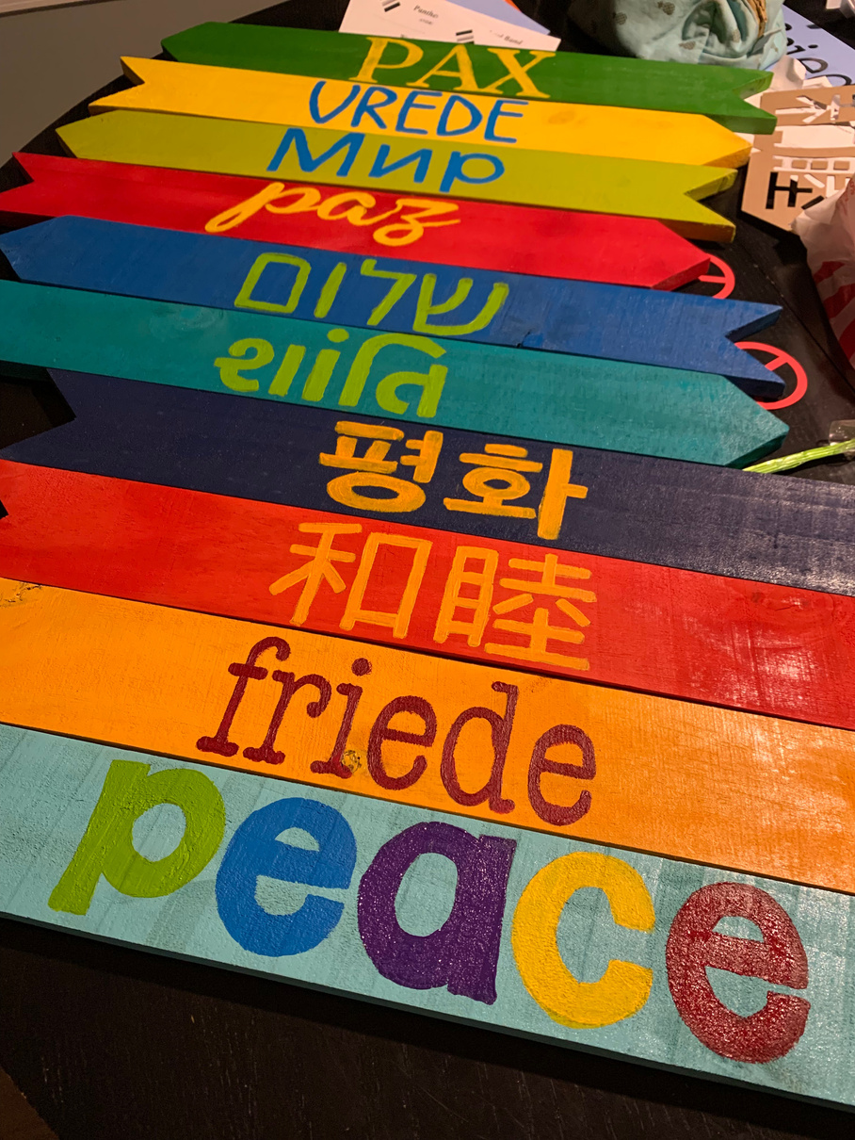
PFSA Mission & Gratitude
The purpose of the PFSA is to further the mission of Sterling by assisting in the promotion of excellence in facilities, programs and atmosphere of Montessori education and by providing aid and services to the school's educational and social functions.
The PFSA encompasses the valuable contributions of all our community stakeholders, Parents/Guardians, Faculty AND Students! We will work closely with our Student Council to make sure our PFSA events include everyone.
We’re able to make this possible through support from our amazing parent volunteers. All Sterling community members will be automatically part of our PFSA, with no membership fees. We hope you will give your time and/or your means to support PFSA’s initiatives for our Sterling community.
Sterling Montessori | 2025/26 PFSA

Slide 4

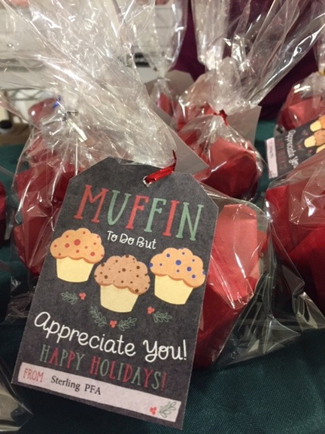
PFSA is Part of Development
PFSA events, professional development and school improvments are all financed through our Treasure Chest (Annual Fund) . The more we raise, the more we can do!
That is why your participation is so vital!
Sterling Montessori | 2025/26 PFSA

Slide 5

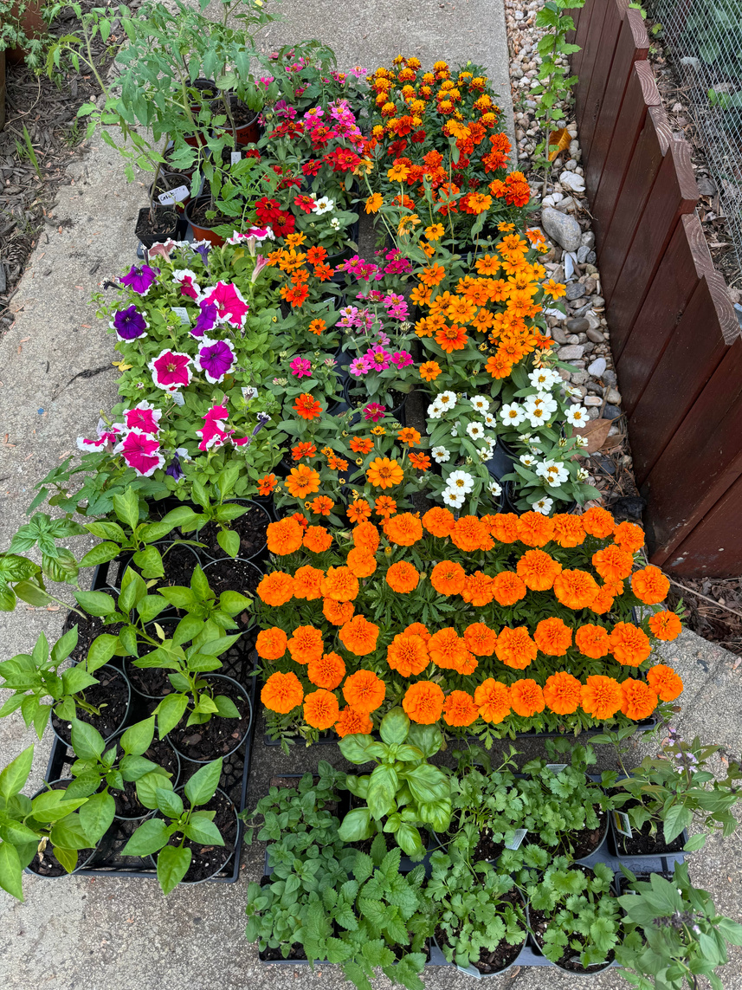

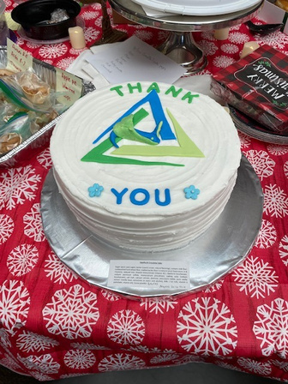


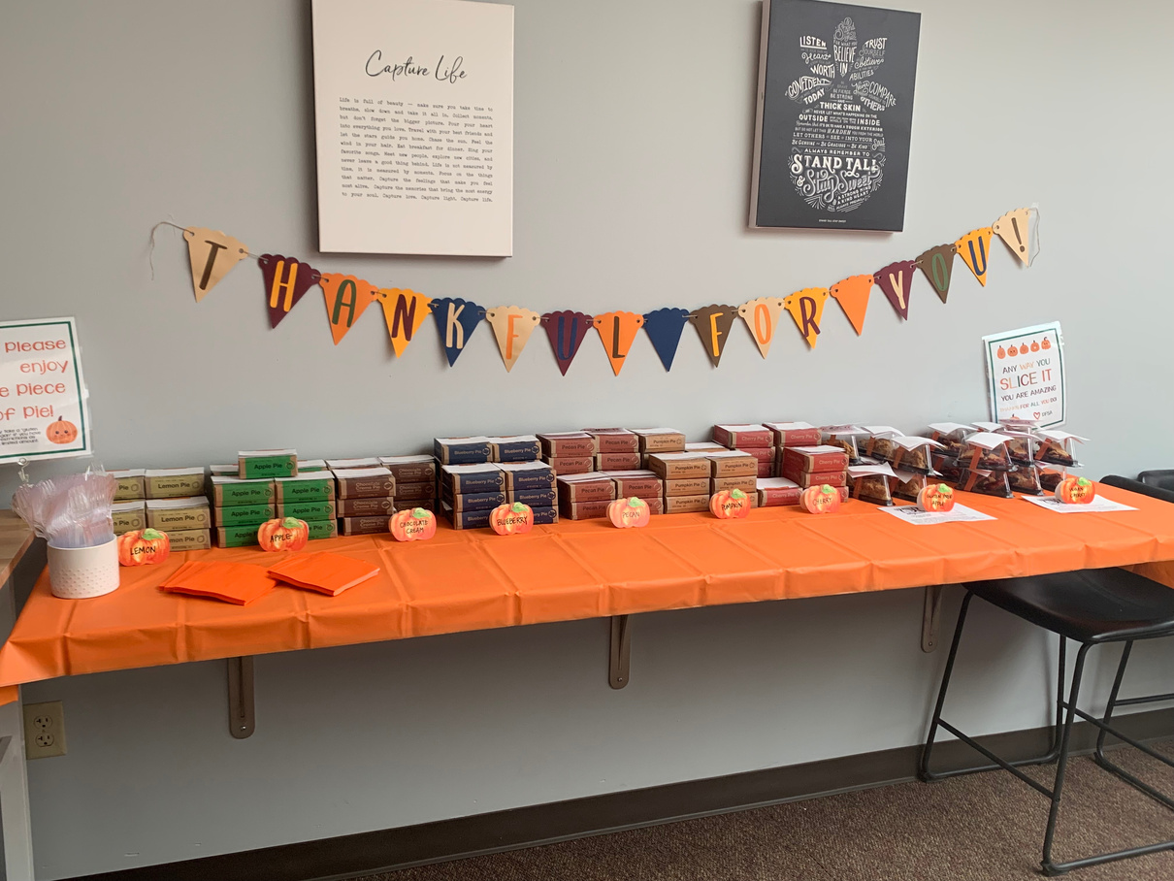

2025/26 PFSA Fall Event Schedule
Picture Days - Oct 1/2;
10th &30th
Movie Night- Oct 3
Giving Tree -
Dec 1-12
Garden Day - Oct 17
Holiday Treat Exchange
Dec 19th
Teacher Appreciation
On-going and Monthly
Giving Tuesday
Dec 2
National Day of Giving
Sterling Montessori | 2025/26 PFSA

Slide 6



2025/26 SPRING Event Schedule
Book Fair - Feb 2-6
Picture Days - March 11/12
Movie Night- Apr 10
Garden Day-Apr 17
International Festivall - Apr 25
Sterling Montessori | 2025/26 PFSA

Slide 7
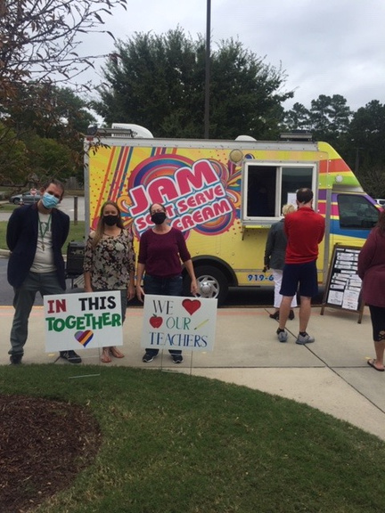
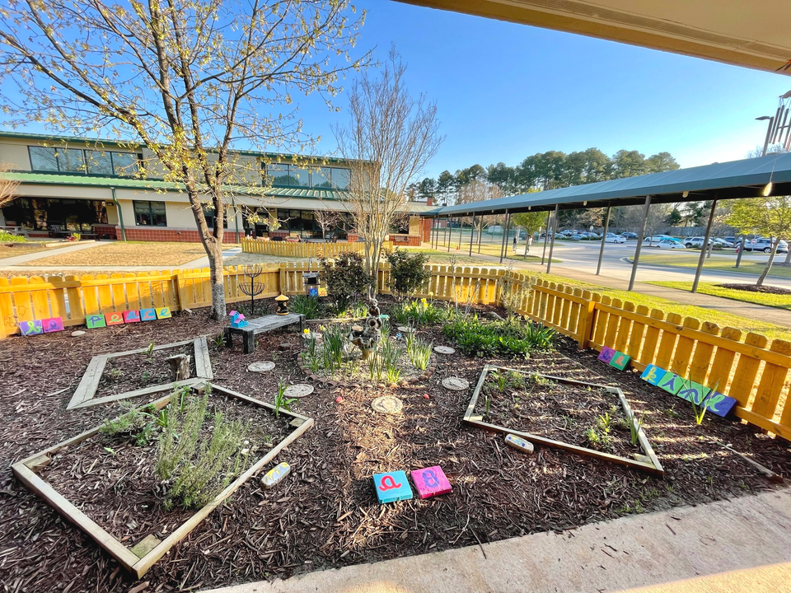
PFSA Event Chairs
  HOSPITALITY/ TEACHER APPRECIATION: Susan English
  INTERNATIONAL FESTIVAL: Faith Meeker
  PFSA FUNDRAISING: Gabrielle DePriest!
  GARDEN DAYS: Kidist Maxwell Fall/Spring Events
  GARDEN DAY BAKE SALES: Jessica Boucher
  MOVIE NIGHTS: OPEN!- Fall/Spring Event
  GIVING TREE: Sarah Sydney
  HOLIDAY TREAT EXCHANGE: Jessica Boucher
  BOOK FAIR: OPEN! - February Event
  PFSA COMMUNICATIONS: OPEN!
  SPIRITWEAR: OPEN!
Sterling Montessori | 2025/26 PFSA

Slide 8
  Check out our Detailed Descriptions of Event Chair Responsiblities & Time Committments on our WEBSITE
  Email pfsa@sterlingmontessori.org with any questions, interests, suggestions or to get involved!
Sterling Montessori | 2025/26PFSA

